Slide 1
Project feasibility

Slide 2
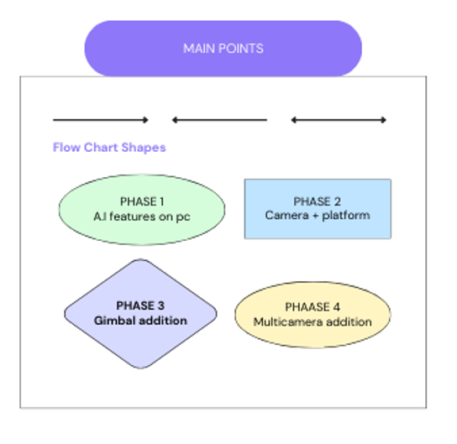

Slide 3
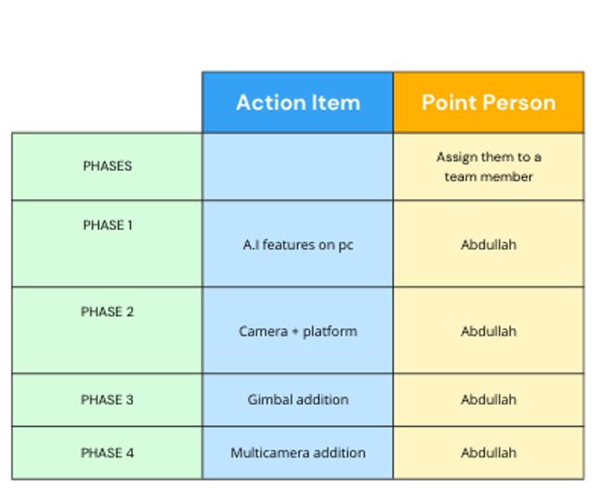
Project phases

Slide 4
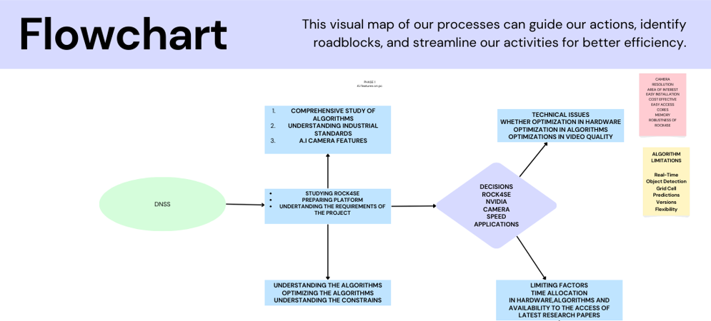
Understanding GPU Acceleration

Slide 5
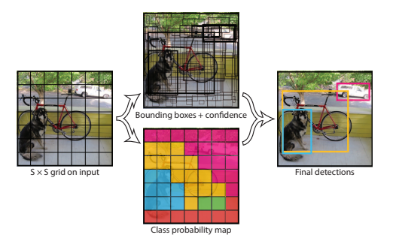
Phase 1
A.I features on pc
Comprehensive study of ALGORITHMS
YOLO V8 comprehensive study phase

Slide 6
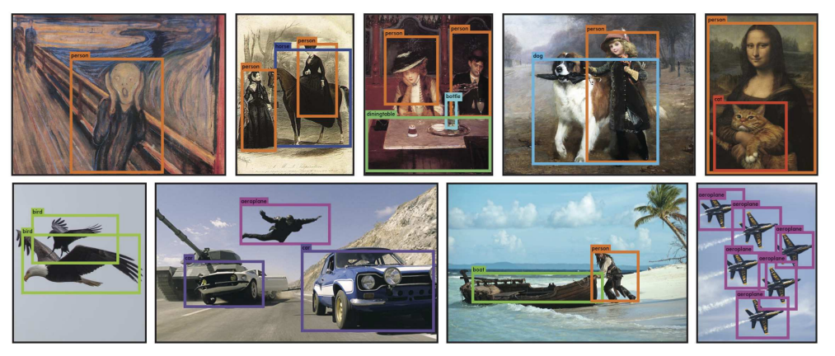
AIMS

Slide 7
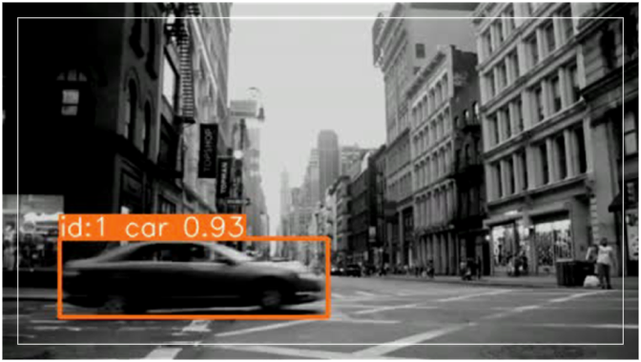
TRACKING is implemented
Video for view

Slide 8
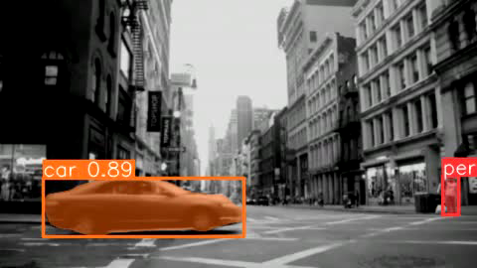
segmentation is implemented

Slide 9
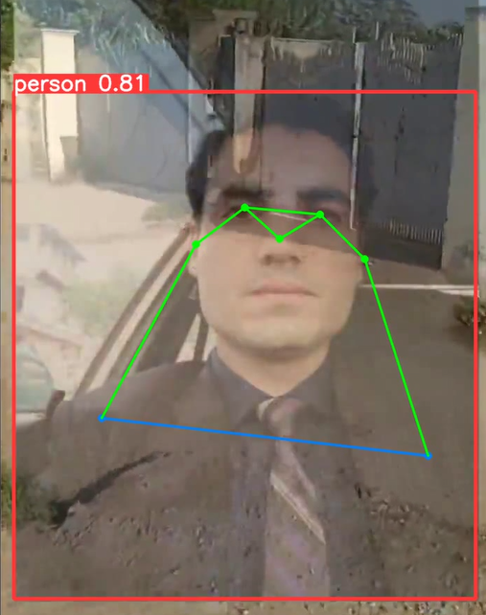
POSING IMPLEMENTED

